Slide 1
ICT 171 TCO PRESENTATION
Mohammed Affan 35737491

Slide 2
What is my project About
CloudArcade is a cloud-hosted website that offers users a collection of five fun and interactive browser-based minigames. The website is created using HTML, CSS, and JavaScript. which allows for a lightweight, responsive, and accessible browser-based gaming experience on all modern browsers.
CloudArcade hosted on a Microsoft Azure Virtual Machine (Ubuntu) using Infrastructure as a Service (IaaS) and an Apache web server, demonstrating key abilities in cloud deployment, server manageability, and highlighting technical and creative skills.
CloudArcade is released under the MIT License (© 2025 Mohammed Affan Parkar), which supports open-source learning, collaboration, and respect for intellectual property.

Slide 3
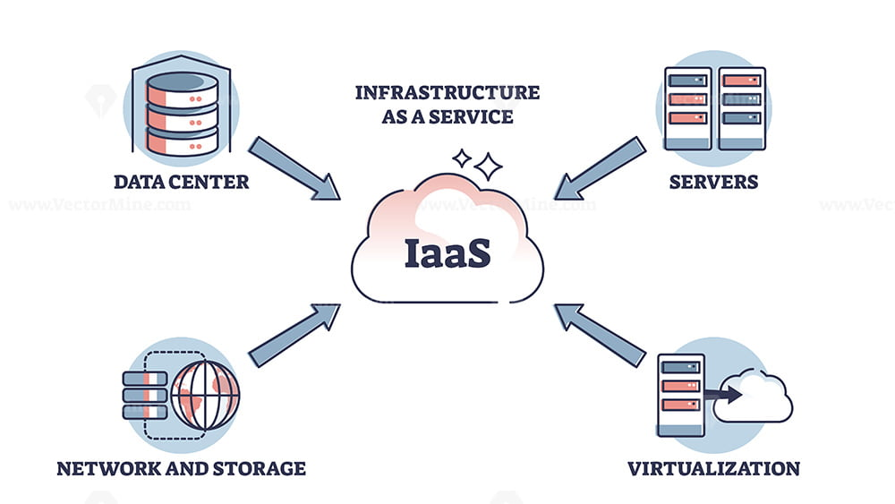
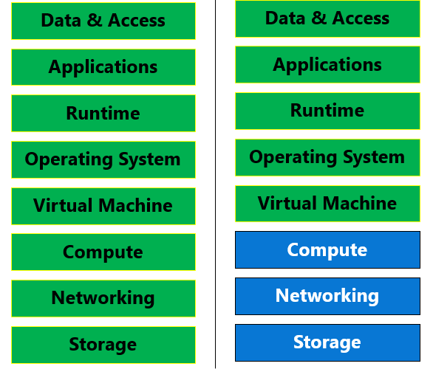
TCO FOR AZURE (IAAS)
Item | Year 1 | Year 2 | Year 3 | Year 4 | Year 5 | Total
Virtual Machine | 96$ | 96$ | 96$ | 96$ | 96$ | 480$
Storage | 24$ | 24$ | 24$ | 24$ | 24$ | 120$
Network Traffic | 6$ | 6$ | 6$ | 6$ | 6$ | 30$
Domain Name | 12$ | 12$ | 12$ | 12$ | 12$ | 60$
Installation | 30$ | - - - - |  |  |  | 30$
Maintenance | 10$ | 10$ | 10$ | 10$ | 10$ | 50$
Security | 15$ | 15$ | 15$ | 15$ | 15$ | 75$
Total per year | 193$ | 163$ | 163$ | 163$ | 163$ | 845$

Slide 4
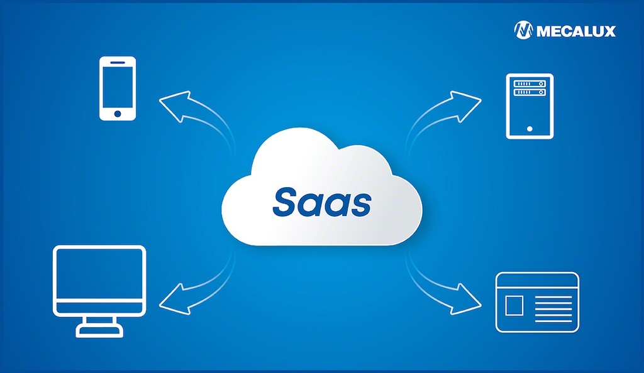

TCO FOR Squarespace (SAAS)
Item | Year 1 | Year 2 | Year 3 | Year 4 | Year 5 | Total
Personal Plan | 192$ | 192$ | 192$ | 192$ | 192$ | 960$
Storage | 24$ | 24$ | 24$ | 24$ | 24$ | 120$
Domain Name | 0$ | 12$ | 12$ | 12$ | 12$ | 48$
Network | Included |  |  |  |  | 0$
Maintenance | Included |  |  |  |  | 0$
Security | Included |  |  |  |  | 0$
Total per year | 192$ | 204$ | 204$ | 204$ | 204$ | 1008$

Slide 5
Comparing Azure (IaaS) to Squarespace (SaaS)
Factor | Azure (IaaS) | Squarespace (SaaS)
5 years total cost | 845$ | 1,008$
Flexibility | Full control over OS, server and code. | Limited flexibility.
Responsibility | User is responsible for setup, configuration, updates, backups, and security patches. | Squarespace manages everything like hosting, security, updates, and maintenance.
Complexity | High technical knowledge of Linux, Apache, and networking is required. | Low technical knowledge required. Squarespace manages everything.
Scalability | Highly scalable. You can upgrade VM specs. | Limited scalability. User can only scale by upgrading to a higher plan.
Performance Management | User can optimize performance manually | Optimized automatically by the Squarespace user has little control.
Security | Must be configured and maintained by the user. | Built-in SSL and automatic security management.

Slide 6


Conclusion
Reference
While Squarespace (SaaS) cost 1,008$ for 5 years Azure (IaaS) cost 845$
Azure offers greater control, scalability, and learning value. But Squarespace is easier to use but it limits in flexibility and customization.
Best option for the project CloudArcade is Azure (IaaS) as it is the better option, cost-effective and ideal for technical skill development.
Microsoft Azure Pricing: https://azure.microsoft.com/en-us/pricing/
Squarespace Pricing: https://www.squarespace.com/pricing

